Slide 1
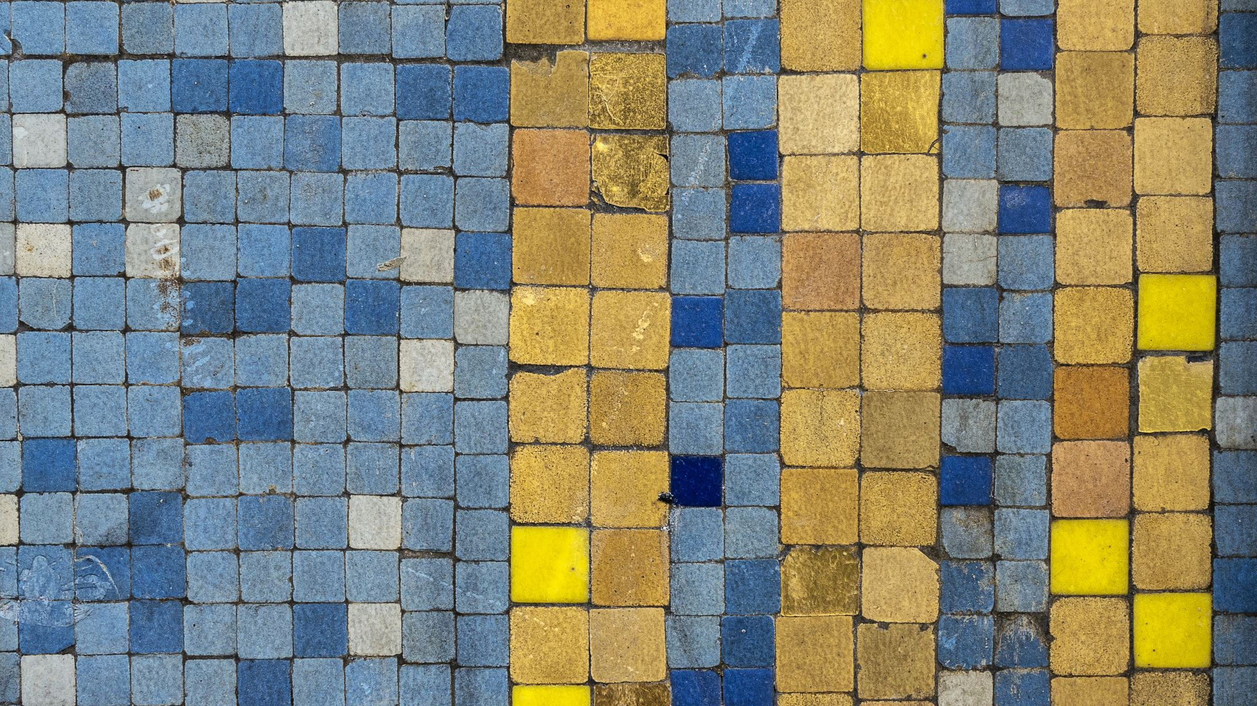
Consequences of Empires

Slide 2
Background
The period from about 1000 to 1250 was dominated by empires in various parts of the world.
These included the Mongol Empire in Asia and the Abbasid Caliphate in the Middle East.

Slide 3
Empires
The term “empire” usually refers to an emperor or government that controls a large area of land with many different communities, societies, and nations.
Some empires, like the Mongol empire, are in one connected land area.
Others, like the British empire in the 18th century, are spread all over the world.

Slide 4
Interaction
Empires usually want the communities within their domain to interact with one another, which leads to the spread of ideas, goods, and technology.
Although empires sometimes establish peace, law, and order, the expansion of empires often causes violence, war, and the destruction of unique cultures.

Slide 5
Worksheets
Follow along with the questions on your worksheets.
Be ready to share your answers with the class.

Slide 6
What is an empire? Do any empires exist today?
An empire will control a huge area of land as well as a great variety of people.
Some people argue that Canada is an empire, because it controls the territories of Indigenous nations. Others say that Canada is not an empire, because it is not attempting to the take the lands, people, or resources of other countries.
Some people argue that the United States is an empire, because it controls many territories in different parts of the world, such as Hawaii, Guam, and Puerto Rico.
Most historians today would say that empires no longer exist, others say that empires continue to exist, we just don’t call them empires anymore.

Slide 7
Let’s look at the some of the empires that existed between 1000 and 1250.

Slide 8
What does this painting tell you about the authority of emperors like Basil? How might that authority have affected the lives of different people living in an empire?
The painting shows Basil being crowned by angels. It is designed to show that the Byzantine emperor has the approval and authority of God.
The people are supposed to bow down to, unquestioningly obey, and provide unwavering support for Basil.

Slide 9
What do the painting of Baghdad and the quotation by Al-Jahiz reveal about the importance of Baghdad to the Abbasid Caliphate? What benefits would such a capital have for an empire?
The painting and quotation show that Baghdad was an important, well-organized city in the Caliphate.
Some possible benefits are:
Impressing the people with its power and wealth, so that no one will question the power of the Caliphate
Protecting the rulers and people from outside attack
Ensuring that the people feel safe and well-governed

Slide 10
How do you think invasions, conquests, and expanding empires affected people living there at the time? (page 54)
Invasions and conquests usually lead to many short-term hardships for people living in the area.
Wars often lead to civilian deaths, plundering, and the disruption of agriculture and other parts of the economy.
Plundering and disruption of economic activity can lead to a long-term shortage of food and supplies.

Slide 11
Note how the Mongol Empire’s boundaries changed between 1206 and 1227. How would these changes have impacted the Mongols? (page 54)
Increased number of people under Mongol control
Larger territory for the Mongols to govern
Could lead to economic success
Could also lead to political, social, and religious challenges as a result of having so many people who may be reluctant to give up their customs and cultures in one empire

Slide 12
Read the quotations from John of Plano Carpini and Paul Ratchnevsky. What consequences did laws have on this empire and its society? (page 55)
The quotations suggest that the laws put in place by the Mongols encouraged people to respect one another and to not commit crimes, out of fear of severe punishments.
It seems that the laws promoted a sense of peace, fairness, and personal security.

Slide 13
Unit Theme: Short- and Long-Term Consequences
What are some of the short-term consequences of a car accident?
01
What are some of the long-term consequences of a car accident?
02
How are these consequences connected?
03

Slide 14
Example
Short—term consequence of a car accident – neck injury
Long-term consequence of a car accident – difficulty playing basketball for many years after
Connection – a neck injury from a car accident has made a person change the way they live their life by finding a different way to exercise and spend time with friends

Slide 15
Short- and Long-Term Consequences of Empires
Consider and connect the short- and long-term consequences of empires.
Example
Short-term - the Abbasid Caliphate was a wealthy empire that was able to build a powerful city like Baghdad.
Long-term connection – because of this history, Baghdad continues to be an important city in the Middle East today

Slide 16
Map Short- and Long-Term Consequences of Empires
Read the article, “Effects of the Mongol Empire on Europe”
With your partner, complete the map of short- and long-term consequences of the Mongol Empire

Slide 17
Trade Routes

Slide 18
Global Exchange
What are some products that we buy in Canada but are made overseas?
What are some ways that we are connected to other countries through trade?
What is a global exchange?

Slide 19
Modern Global Exchange
Global exchange often comes along with technological advancement.
Some examples from today include:
Multinational businesses that use Skype for meetings
People who eat fruits like mangoes, avocadoes, and lemons through the winter because they have been shipped in from countries like Nicaragua and Peru
The clothes you are wearing are probably from a country like China, Vietnam, or Indonesia

Slide 20
Ancient Global Exchange
Increased global exchange as a result of technology has been happening for a long time.
One example is the Silk Road, which allowed people from many different regions to trade more easily when a reliable road was built.
This reached new levels during the Mongol Empire, when soldiers protected the roads and made it safer for travellers.
https://ed.ted.com/lessons/the-silk-road-history-s-first-world-wide-web-shannon-harris-castelo#watch

Slide 21
Video Discussion Questions
Where did the Silk Road begin? Where did it end?
How did nomads contribute to the growing networks of trading routes?
How was the quality of life in China changed as goods were traded?
How did conflict, compromise and negotiation over the availability of resources impact the economic development of civilizations (i.e. creation of powerful trading networks, transmission of weapons technology, etc.)?
Why do people trade goods and services?

Slide 22
Group Map Assignment
Work with your group mates to create a map of the short- and long-term consequences of the Mongolian Empire that brings together all your ideas.
Make as many connections between the consequences and to the modern world as you can.
We will put these ideas on the board, so be prepared to share your ideas.

Slide 23
Silk Roads Activity
You will receive a package with a map and several worksheets on the various cities of the Silk Road.
1
You will walk around to the various cities, read the information, and answer the questions about the cities.
2
After you have visited all the cities, connect them on your map to see how the Silk Road was formed.
3
You will hand in your packages when you have finished gathering all the information.
4

Slide 24
Silk Roads Activity Follow-up
Cultural exchange led to a change in artistic expression in places like Samarkand. Samarkand was an example of a cultural exchange between Chinese, Turks and the Samarkand royalty. The Silk Road impacted the world by advancing civilizations and causing an age of exploration that led to the exploration of the Americas. People and countries around the world exchange goods to enhance their own civilization by sharing ideas, including religious beliefs.

Slide 25
Trade Networks (pages 56-57)
Read the text and answer the questions on a separate piece of paper.
How would an empire’s trade connections have impacted its people and the people with whom it traded? Looking at this map and the other sources in this section, what long-term consequences can you see from these connections today?
What impact would these protections have had on trade along the Silk Road? How would the empire have benefited?
After considering these examples, name at least two consequences of trade networks for people at the time. Which consequences are still present today?

Slide 26
How would an empire’s trade connections have impacted its people and the people with whom it traded? Looking at this map and the other sources in this section, what long-term consequences can you see from these connections today? (page 56)
Trade connections would have led to the spread of goods, ideas, and people.
Long-term consequences include the creation of wealth, spread of religions, development of trade agreements, new industries, a common currency, and the building of new communities.

Slide 27
What impact would these protections have had on trade along the Silk Road? How would the empire have benefited? (page 56)
Protections would have allowed travelers and goods to move easily, quickly, and safely.
The lowered taxes would have made the journey less expensive, which would also keep prices down and encourage more people to buy goods.
This would have encouraged merchants to increase the amount of goods they were importing and exporting.

Slide 28
After considering these examples, name at least two consequences of trade networks for people at the time. Which consequences are still present today?
People who mined natural resources and the merchants who sold them became wealthy
People’s lives became easier as they gained access to food, fabrics, and other goods
Trade networks promoted peaceful relations between people, who could trade for resources rather than fighting over them

Slide 29
Silk Roads Flyer Assignment
Choose one of the objects that you encountered during the Silk Roads activity.
Imagine that you are a merchant on the Silk Road who wants to bring customers to your shop.
Create a flyer for that object that includes the following information:
A picture of the object
Why this object is valuable
How this object relates to cultural exchange
Why customers should come to your city

Slide 30
Flyer Assignment Rubric
Criteria | Emerging | Developing | Proficient | Extending
Evidence and Interpretation Considers the context in which the object was created (can provide detailed information about the object)
Analysis Argues why the object and the city should be considered significant (can explain the positive short- and long-term consequences of travelling to the city and purchasing the object)
Communication and Justification Communicate using the most appropriate or effective form, using image, text, and media (flyer is creative, colourful, and easy to read)

