Slide 1
Fundamentals of Essay Writing

Slide 2
Basics
Why do we write essays?
What is the purpose of a literary essay?

Slide 3
Why Essays?
Essay writing is an interesting form because it has a structure and format that need to be followed.
However, there is an element of creativity and personalization within the essay that makes it exceptional and different from other academic work.
The structure and organization make an essay instantly recognizable and easy to process for the reader, while the writer can express their ideas creatively and fluidly.

Slide 4
Literary Essays
A literary essay makes an argument about a text and defends it.
It gives your opinion about a particular element of the story (characters, themes, symbols, etc.).

Slide 5
Basics
Format
Mechanics and Grammar
Content
Organization
Language
Writing Process
Rubric

Slide 6
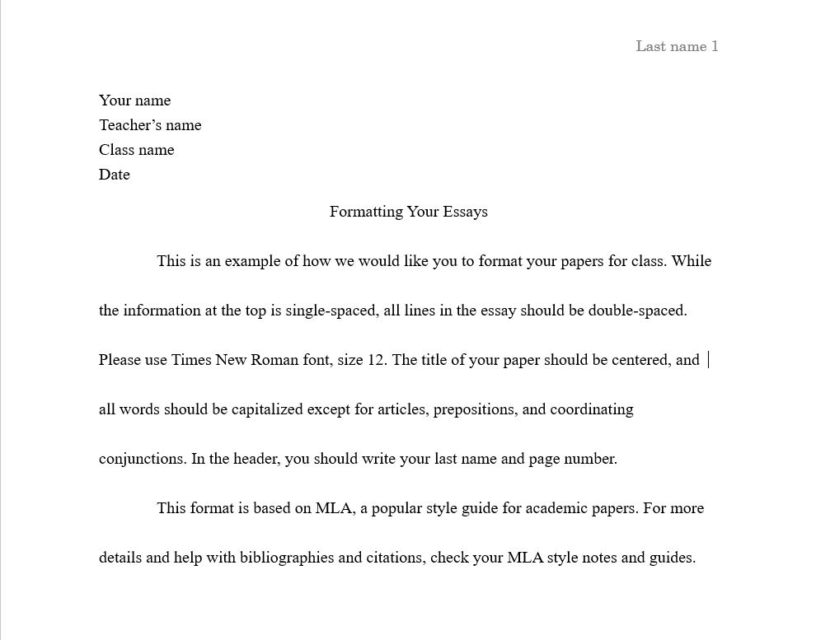
Format

Slide 7
Format
This is an example of MLA format, which most of your humanities college courses will require you to use.
When writing your in-class essay, you should mimic this style as closely as you can.

Slide 8
Mechanics and Grammar
An easy way to lose marks.
Look out in particular for run-on sentences, sentence fragments, and improper use of semicolons.
Proofreading – read your paper aloud to yourself.

Slide 9
Content
Make sure you actually answer the question.
Take pity on your marker – originality, creativity, and legibility.

Slide 10
Organization
As a group, create a diagram of an essay on the chart paper.
What are the parts of an essay called and where do they go?
Essay structure diagram

Slide 11
Organization: Introductions
What are some ways to write an engaging hook?

Slide 12
Organization: Funnel Introductions
Begins with one or two general sentences.
Each sentence becomes increasingly focused on the topic.
The last sentence states specifically what the essay will be about (thesis statement).

Slide 13
Organization: Attention-Getting Introductions
Dramatic, interesting, or funny story
Surprising statistics or facts
Historical background
A real fact or bit of information
Dialogue
A meaningful quotation
A universal statement that applies to the text

Slide 14
Organization: Introduction Example
During the Great Depression of the 1930s, thousands of Americans lost their jobs and their homes when farms and businesses failed and unemployment and poverty exploded. As a result, many were “set adrift” to wander and to seek work in strange places. This rootlessness created a jarring contrast to the ideal of the American Dream that so many Americans had been led to believe was within everybody’s reach: that if you work hard enough, you can create your own fortune, no matter what. In his novel, Of Mice and Men, set in the 1930s, John Steinbeck portrays several of these lonely, drifting characters who are struggling under the difficult times of the Great Depression. Characters are skeptical of companionship and are reluctant to make connections to any person or place. The novel illustrates the emotions, hopes, and disappointments of these characters, who opt out of the belief in owning property and being a member of a community because of the miseries that they suffer every day. In Of Mice and Men, Steinbeck uses the emptiness of the ranchers’ lives to show the American Dream to be nothing more than a myth that is impossible to achieve.
Source: https://bhsenglish.com/the-funnel-introductory-paragraph/

Slide 15
Organization: Introduction Example
Staying Healthy example essay
What kind of introduction is being used?

Slide 16
Organization: Thesis Statements
What is the purpose of a thesis statement?
How does one write a good thesis statement?

Slide 17
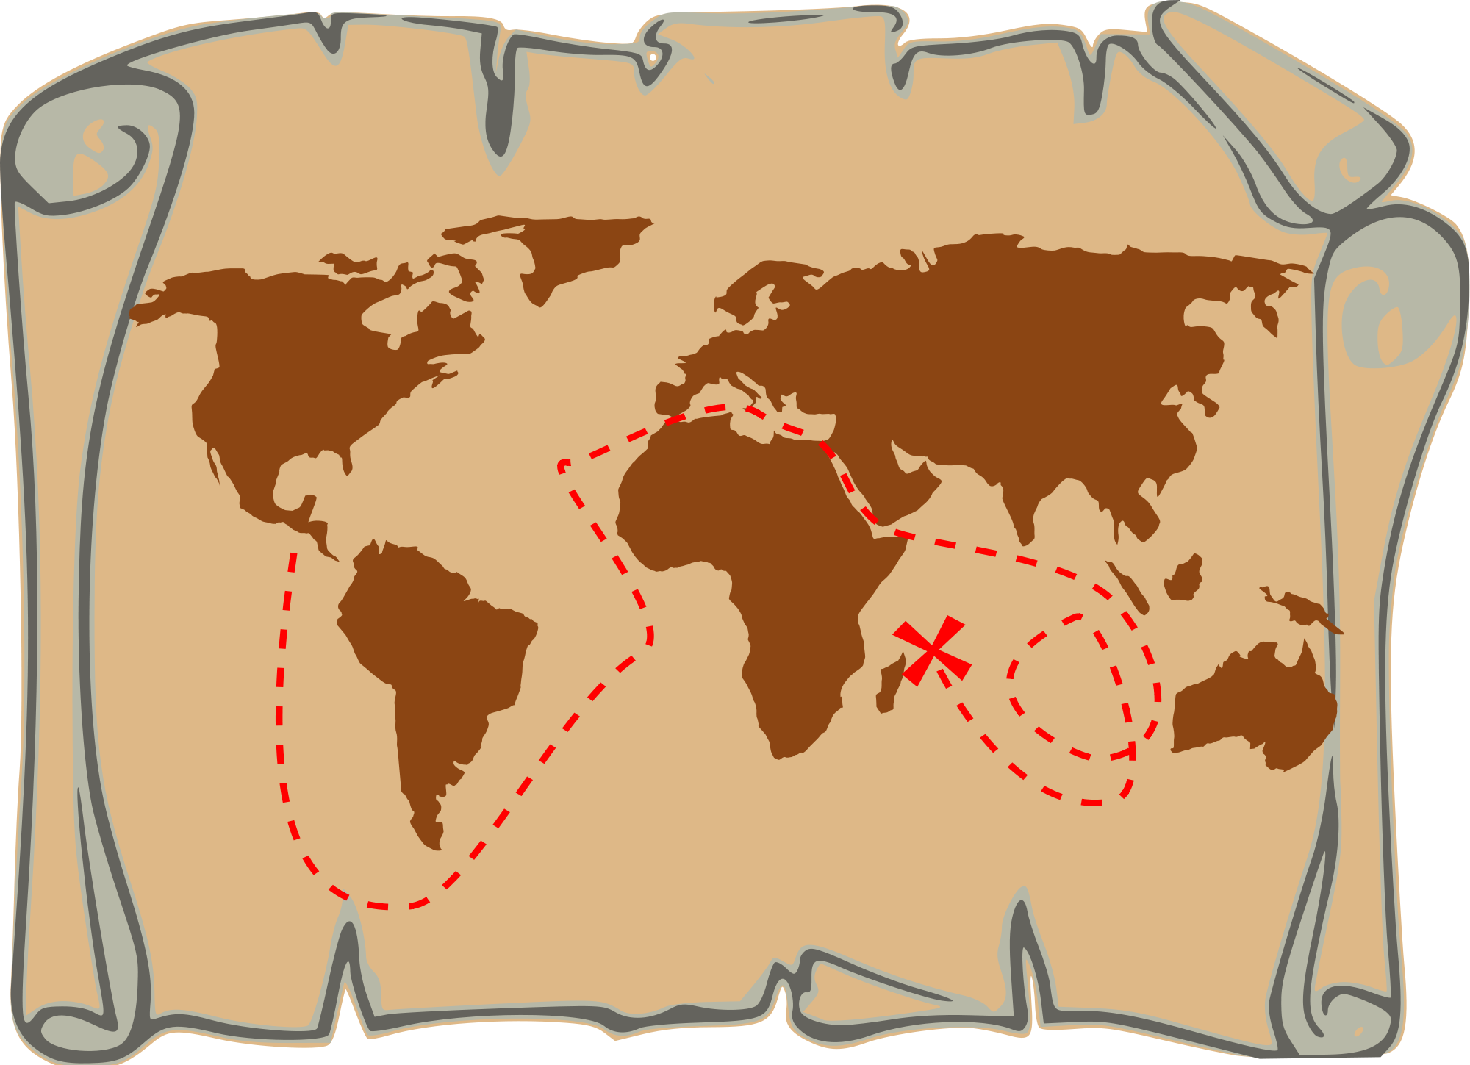
Organization: Thesis Statements
The purpose of a thesis statement is to provide a map of your essay.
Your reader should know exactly what to expect by reading only your thesis statement.
Just answer the question.

Slide 18
Organization: Thesis Statements
State the specific topic.
May list subtopics or subdivisions.
May indicate the pattern of organization.
Is usually the last sentence in the paragraph.
In one sentence, clearly and concisely answer the prompt. Make sure to include the title and author (TAG).
Thesis statements are the most important part of your essay! If you do not have a thesis statement, you do not have an essay.

Slide 19
Thesis Statement Pitfalls
Do not choose a thesis statement that is obvious or vague.
The Chrysalids is a story about a post-apocalyptic world where many people are mutants.
First of all, yes, obviously.
Second, this is a summary, not an argument.

Slide 20
Thesis Statement Pitfalls
Choose a thesis statement that makes an opinion that can be argued.
In the novel The Chrysalids, John Wyndham presents a discriminatory, post-apocalyptic world as a powerful allegory for the genocide of WWII.

Slide 21
Organization: Paragraph Structure and Quote Integration
Topic sentence
Lead-in
Quote
Commentary
Lead-in
Quote
Commentary
Lead-in
Quote
Commentary
Conclusion

Slide 22
Organization: Paragraph Structure and Quote Integration
“People are so thoroughly under control that they have even given up their abilities to feel strong sensations. One of the first differences between Jonas’s world and ours to become evident is the lack of color. Jonas catches glimpses of red in an apple he is playing with and in the hair of his friend, but he does not truly experience it until the Giver transmits a memory of sledding to him. He looks at the sled beneath him and is shocked to find that the sled has “that same mysterious quality that the apple had had so briefly. And Fiona’s hair” (93). Between his own inherent abilities and the memories that are being given to him, Jonas is able to uncover the first layer of the human legacy that he and his fellow community members have been robbed of. Jonas dives deeper into that world when he discovers the concept of love. When he asks his parents if they love him, they respond that love is “a very generalized word, so meaningless that it’s become almost obsolete” (127). This is a shock for Jonas and for the reader, because love is such a strong and integral aspect of our lives. It is hard for us to imagine a life without the love of our families and friends. With this experience, Jonas finds that his life lacks one of the most important components of human existence. The final, most devastating revelation comes when Jonas watches his father release a newchild. At first, Jonas thinks that his father will take care of the child and help send him to a special place, but as he watches the ceremony and recognizes the familiar gestures from his memories, he realizes that his father has not saved the child, but that “[h]e killed it” (150). With this final realization, Jonas comes to understand how completely his community is being controlled. They commit murder with no feeling and no understanding. The oppression of this society becomes complete when the people are cut off from the basic, universal experiences that are shared by every human on our planet. By coming to understand this, Jonas makes his final decision to free his community from this oppression.

Slide 23
Organization: Concluding Paragraph
The concluding paragraph should start by restating your thesis.
Make sure to mention the title and author again.
A complete concluding paragraph will also do one of the following:
Relate the thesis statement to the book as a whole
Comment on how successful the author is
Say something personal
Make a prediction
Give an opinion of the novel’s value or significance

Slide 24
Organization: Concluding Paragraph Example
In Lois Lowry’s The Giver, we are taken into a dystopian world where the people no longer have control over the basic aspects of their own lives. The story ends with Jonas sacrificing everything in order to give this control back to the people. It is a compelling conclusion that moves the reader to not only stand up for and defend the rights of the people, but go out and laugh, cry, love and explore. These are the birthrights of every human on this world, and we are reminded of the need to enjoy them in all their complexities.

Slide 25
Language: Register
What is register?

Slide 26
Language: Register
Linguistics
A variety of a language or a level of usage, as determined by degree of formality and choice of vocabulary, pronunciation, and syntax, according to the communicative purpose, social context, and social status of the user.

Slide 27
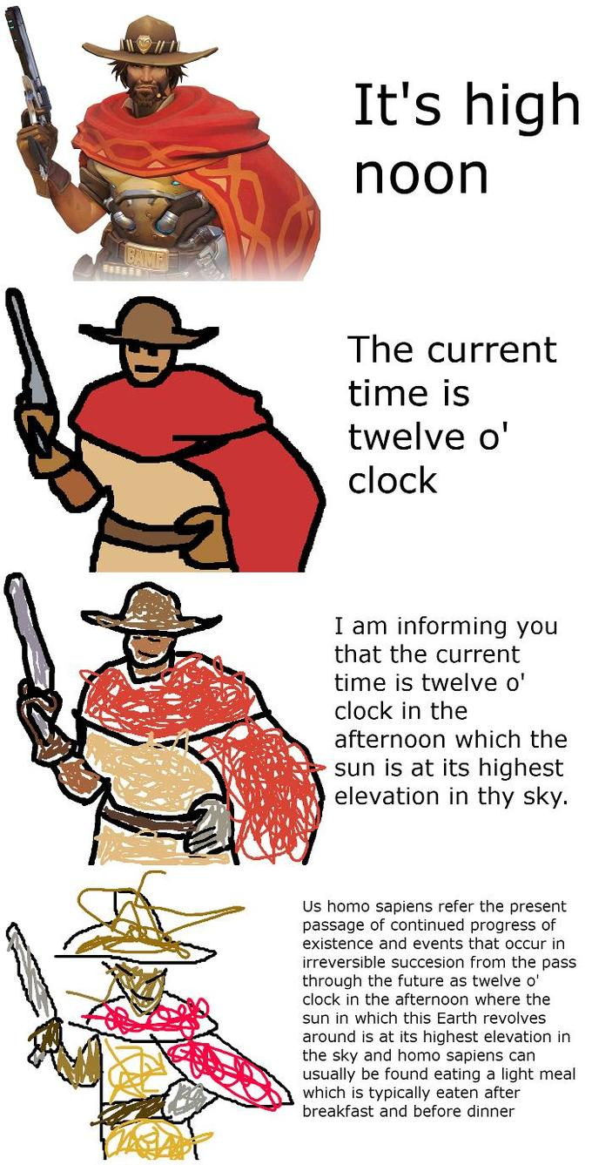
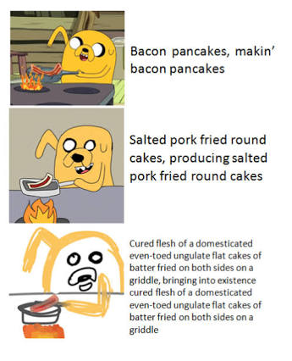
Language: Register

Slide 28
Language: Register Shifting Activity
Choose a popular song.
Pick 3-4 lines from that song.
Shift them as far up as you can.
Don’t tell anyone what song you are doing!
Read the lines to the class and have your classmates guess which song you did.

Slide 29
Language: First Person Pronouns
Is it appropriate to use first person pronouns (I, my, me) in academic essays?
Why or why not?

Slide 30
Language: First Person Pronouns
In general, it’s best to avoid first person pronouns when writing academically.
Removing first person pronouns and irrelevant opinion language makes the writer sound more authoritative and confident.
“I believe that Vancouver is a great city to live in.”
“Vancouver is consistently rated as one of the most livable cities in the world.”

Slide 31
Language: Contractions
In general, academic writing does not include the use of contractions.
“If you ask me, Waknuk isn’t a very tolerant place."
“Waknuk society lacks diversity and tolerance.”

Slide 32
Language: Literary Present
Literary essays are written in the literary present tense.
This is because artistic works are considered to exist in the “eternal present”…they are always happening.
The literary present is also used if you are quoting a text. You must show the change with square brackets.
Original: He charged the card and left with a sigh.
Quote: “He charge[s] the card and [leaves] with a sigh.”

Slide 33
Writing Process
You should always include evidence of planning, such as a brainstorm or outline.
For essays that are written outside of class, you should go through the process of prewriting, drafting, editing, self and peer evaluating, and publishing.
Every successful author ever has gone through this process, so you should too.

