Slide 1
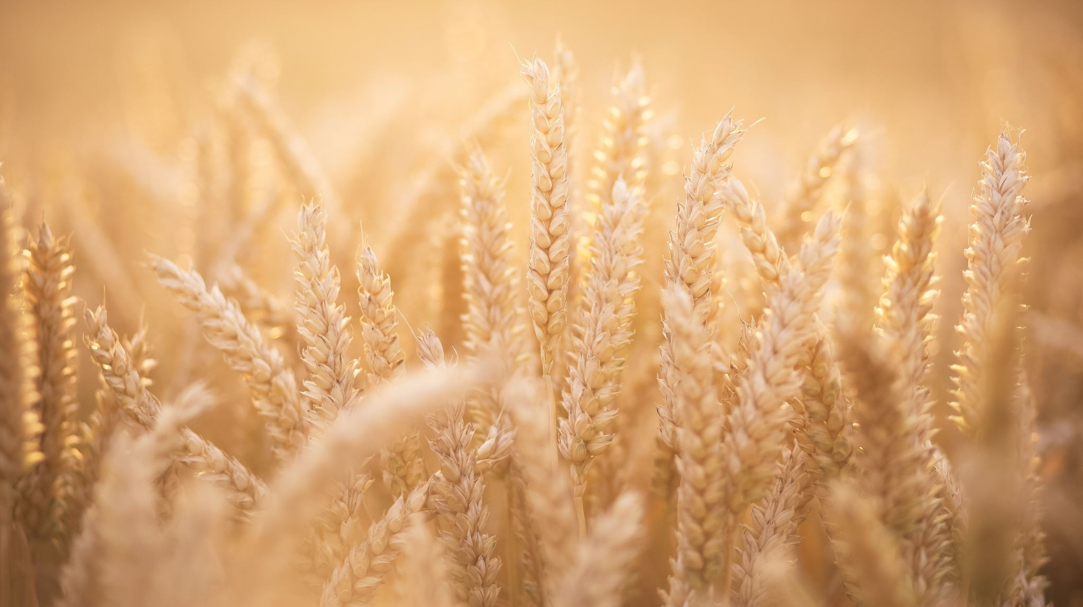
Consequences of Empires and Indigenous Peoples

Slide 2
One the main reasons that we study history is to learn from the past and apply those lessons to the present.

Slide 3
First Peoples of Canada
We have been considering the consequences of expanding empires.
Canada is also the product of a colonizing and expanding empire.
How did the British and French empires impact the Indigenous peoples of North America?

Slide 4
Video
Watch the video about the consequences of colonization for Indigenous peoples.
https://www.youtube.com/watch?v=rRWnxZdZ3_I

Slide 5
Activity
In the same way that you created maps of the consequences of the Mongol empire, you will now create a map that considers the consequences of the British and French empires in North America.
Make sure to include the short- and long-term consequences that are mentioned in the video.

