Slide 1
The Middle Ages 1000-1250

Slide 2
Group Discussion
How does the government maintain its power over society and its territory?
What are some symbols of government power?
How does a government gain or lose power?

Slide 3
Group Discussion
How does the government maintain its power over society and its territory?
Passing laws
Having an army
Having a police force
Advertising on TV and online

Slide 4
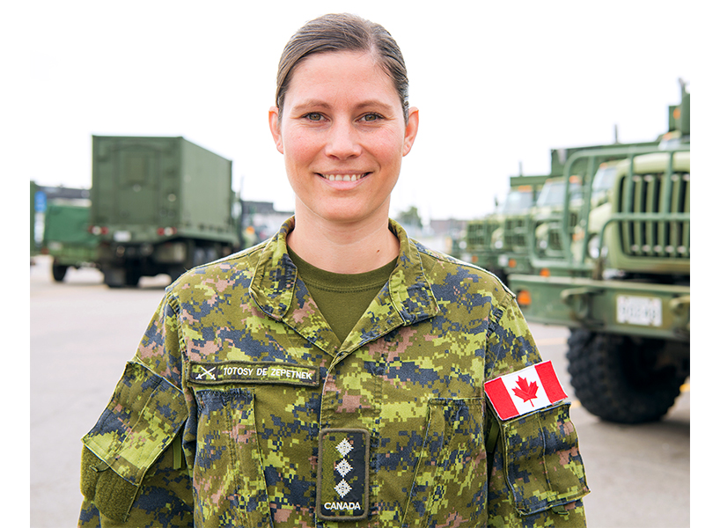
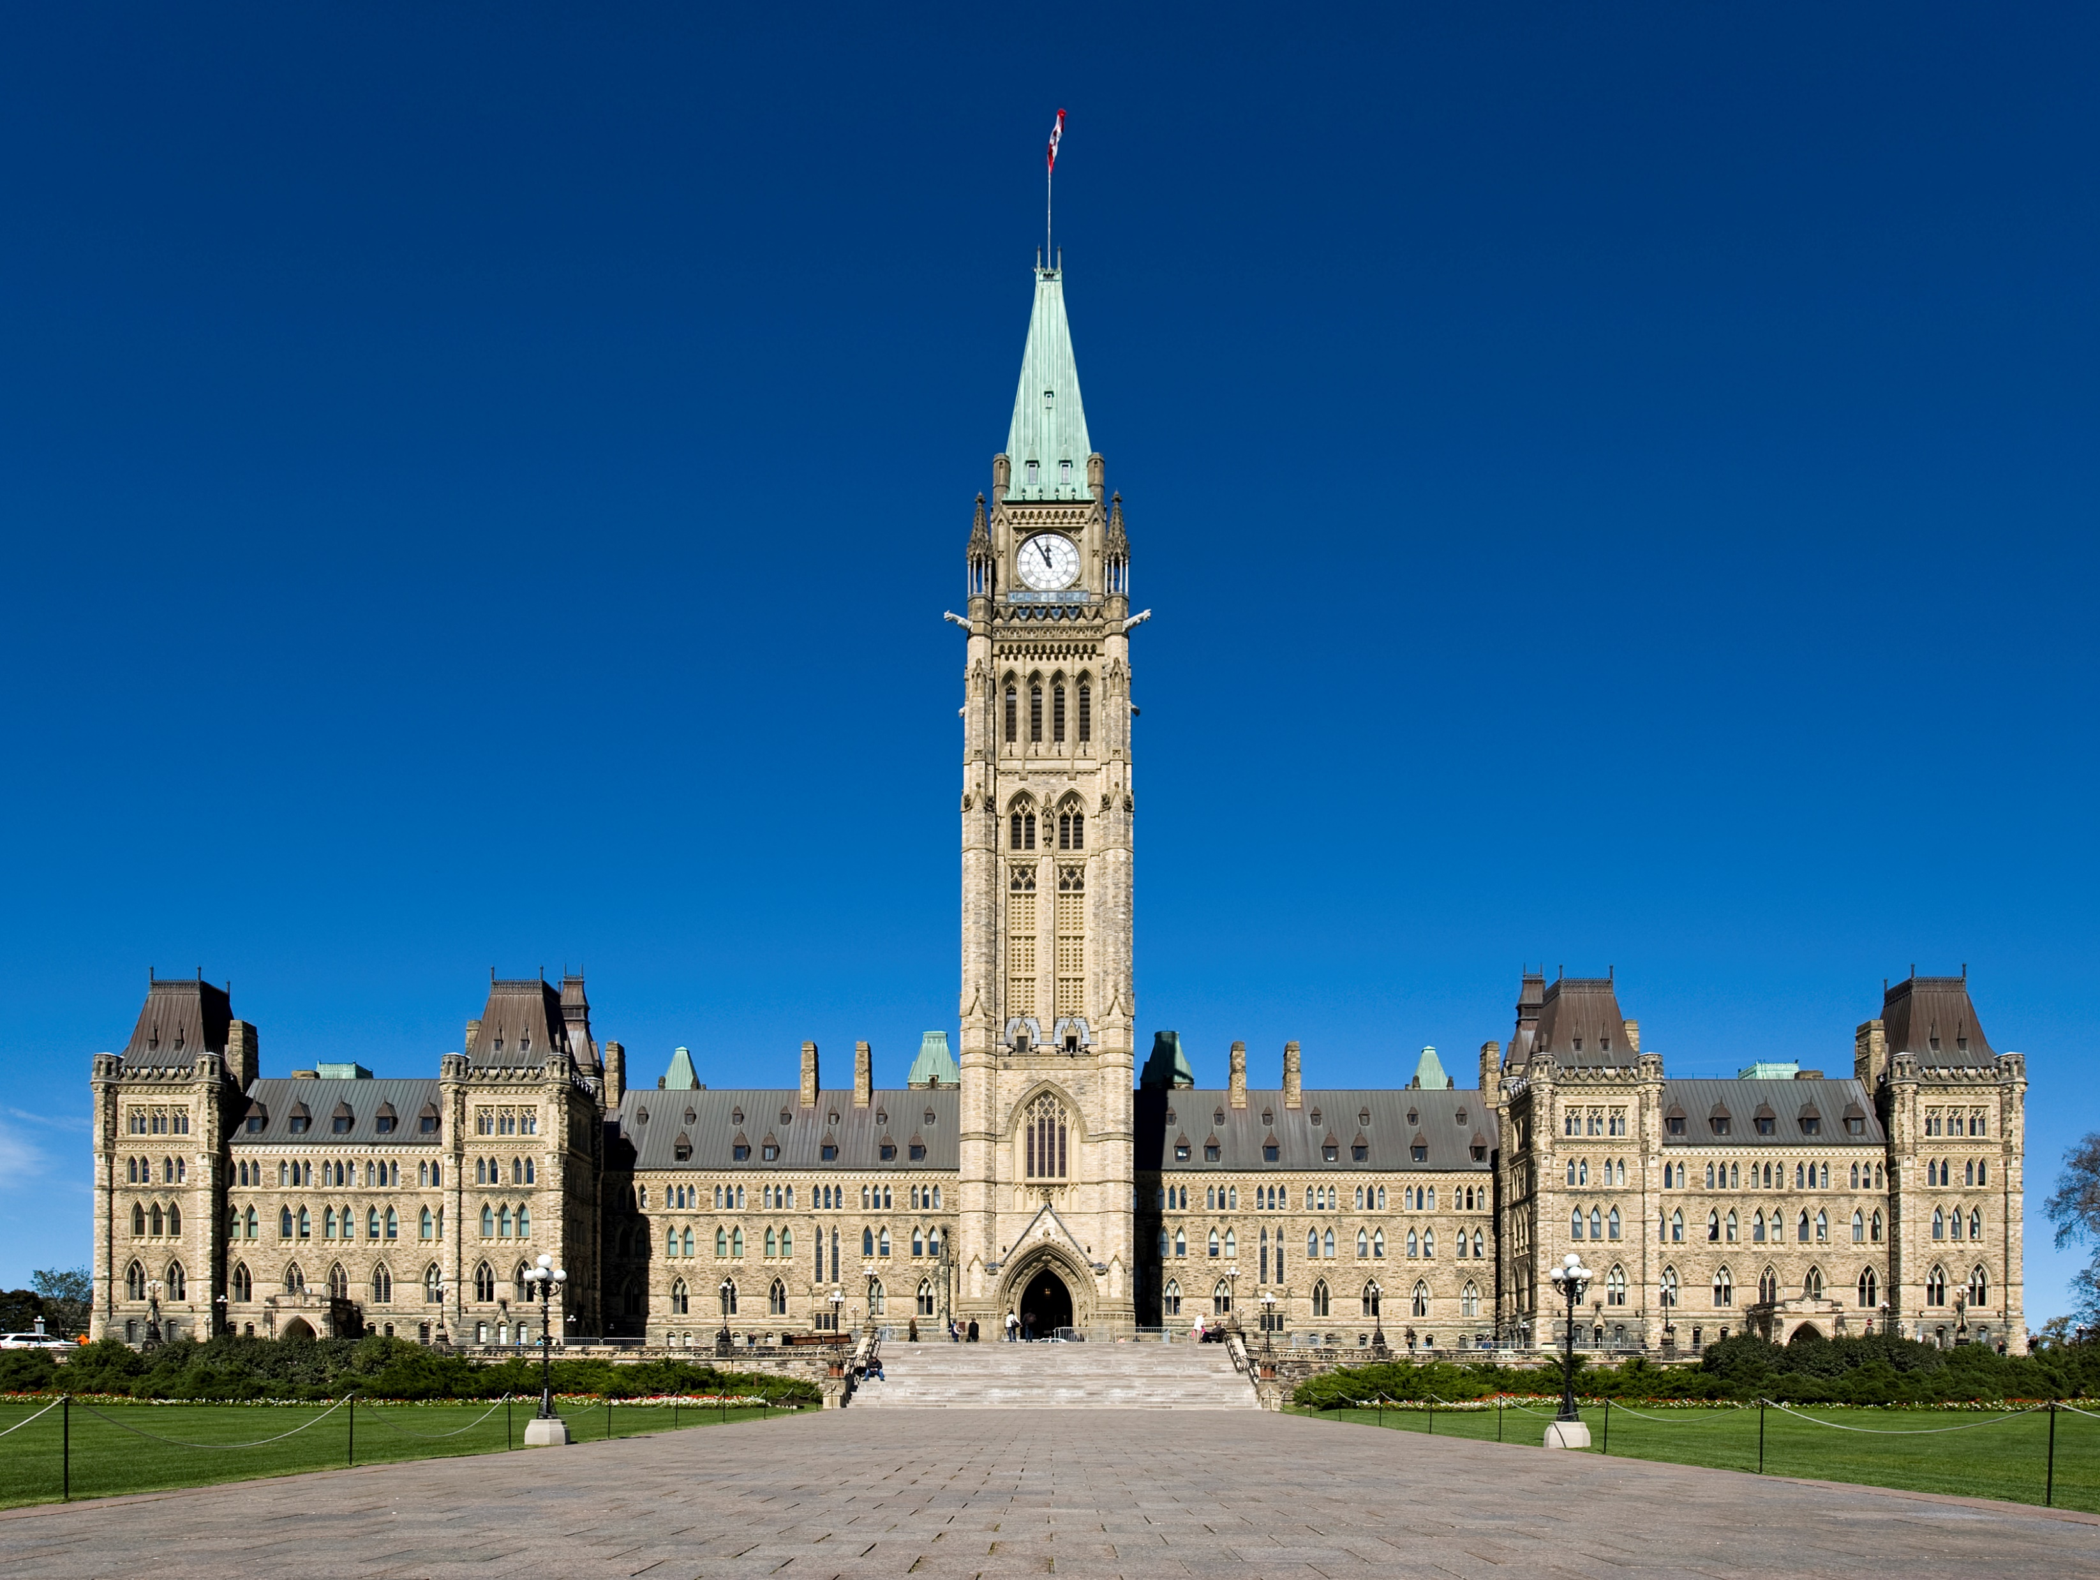
Group Discussion
What are some symbols of government power?
Flag
Logos
Military and police uniforms
Governmental building

Slide 5
Group Discussion
How does a government gain or lose power?
Elections
Rebellions
Coups

Slide 6
Picture – pages 44 and 45
What do you think the picture shows?
What evidence do you have to support your idea?
What does this picture tell you about how power was exerted in the Middle Ages?

Slide 7
Picture
The image is of an army attacking a castle.
You can tell from the horses, weapons, and the people defending the wall on the right.
The crosses on the horse’s caparison (cape) tell us that this is a Christian army and the reason for the battle is religious.
The picture tells us that power was exerted by using military force in the Middle Ages.

Slide 8
Crusades
These battles were called Crusades.
The Crusades were a series of battles or military expeditions made by European Christians to capture the Holy Land from Muslims.

Slide 9
Crusades Video
Watch the video and answer the questions on the worksheet.
https://www.youtube.com/watch?v=X0zudTQelzI

Slide 10
Questions – page 46
Read page 46.
Discuss the two questions with a partner.
What do these two works of art suggest about life in each society?
How might Christians in the Byzantine Empire have viewed the Seljurk Turks and their expanding empire? (compare this map to the map on page 36)

Slide 11
Top image is from the Muslim world.
It is of people listening to a teacher.
It suggests that the Muslim world was focused on learning and innovation at this time.

Slide 12
Bottom image is from the European world.
It shows an overlord threatening violence as the serfs work.
It suggests that life in the feudal system in Europe was difficult for most people.

Slide 13
The Expanding Empire
The map shows that the Seljurk Turks had expanded their territory into Jerusalem and the area that the Christians considered to be the Holy Land.
This area had previously belonged to the Christians.
Christians would have seen the Muslim expansion as a threat.

Slide 14
Written Responses
Read pages 47 to 49
Answer the four questions in the textbook:
What do these quotations tell you about the perspectives of Pope Urban II and Salah al-Din, and how they saw Jerusalem? What similarities do you notice between the two quotations?
What does the illustration reveal about the artist’s perspective on the crusaders and their mission?
How does the author view the crusaders? How does he view Muslim leaders?
How do you think Muslim viewed Salah al-Din’s victory over the crusaders? How do you think Christians viewed it? Why?

Slide 15
Review with Crusades PPT
Do lesson on Golden Age of Islam

